Slide 1
Argonaut 2020 Patient Lists: HL7 Connectathon 26 Track Orientation

Slide 2
Outline
General FHIR Connectathon Introduction
Dates
Track Selection
Argonaut Patient Lists Introduction

Slide 3
HL7 Connectathon 26
VIRTUAL - January 13, 2021 - January 15, 2021
Connectathon Registration is open click HERE for more information

Slide 4
Track Selectiontion
Review track details to find your focus
2020-09 Connectathon 26 Confluence page
Complete survey for each member of your team to indicate their primary track
Contact Sandy Vance at sandy.vance@aegis.net for any questions
Patient List Track Details
Connect with me, your track lead in advance
We recommend participating fully in only one track
Come prepared -do your HomeWork ahead of time

Slide 5
Patient List Track details
Breakouts
Kickoff and Wrap-up
Focus on newbies to get up to speed
Servers
Q/QR
Encounter/Appointment extension
Big lists ( paging etc)

Slide 6
Patient List Resources
Argonaut page: https://confluence.hl7.org/display/AP/Current+Projects

Slide 7

Who am I?
Eric M Haas, MS, DVM
Consultant Health eData Inc
Email: ehaas@healthedatainc.com
FHIR Zulip Chat
Co chair Carl Anderson
Picture pending..

Slide 8

Argonaut Patient Lists
Scope
Background
Sketch of API
Implementation Experience
Demo
Roadmap
Next Steps
Resources

Slide 9

Argonaut Patient List Project Scope
GOAL: Support interoperable and standard exchange using the FHIR API for exposing existing EHR user-facing patient lists
“System Generated” Lists (e.g., Calender for the day showing patients)
“User Generated” Lists (e.g., Patients I want to follow up on)
Write is Out of Scope
Final Work Product will be an implementation Guide
Notes:
Writing, creating or managing a patient list is out of scope for this IG. Fetching client defined patients lists is also out of scope.

Slide 10

Background
User-facing apps often need to know things like:
“Who are the patients I’m seeing today,”
“Who are the patients I’m responsible for in the hospital right now,”
“Who are the patients in this ward.”
This core functionality is already supported by EHR systems
However no standards based guidance for creation of and manipulation of patient lists currently exists.
Several Options:
Search
Assemble Patients in List Resource
Assemble Patietns in Group Resource
Notes:
Note: When we say “EHR” in this document, we don’t mean to limit ourselves to electronic health record systems; the same technology can be used in HIEs, care coordination platforms, popoulation health systems, etc. Please read “EHR” here as a short-hand notation for something like “interoperable healthcare platform”.

Slide 11
Sketch of API
Patient List Uses the FHIR Group Resource
1. Discovery of ‘User Facing’ Lists
2. Fetch Patient List
3. Fetch Additional Data about each Patient

Slide 12
REMEMBER
For Patient List Think Group Resource
For our use case, Group lists members (`actual` = true) and members reference Patients using their logical FHIR ids.
Notes:
Sidebar Group vs List Resource:
There is some overlapping functionality between List and Group in FHIR. The methodological difference is that:
Group is an actor - a collection that can be a subject of an observation, a recipient of data, etc. It is primarily defined by criteria…
List on the other hand, is NOT an actor. It is an organizer for presentation purposes only. It is always enumerated and has no defined criteria.
Whether this difference merits 2 distinct resources remains an open question. The key practical advantages of Group is:
Support of the element and searchparameters for both the type - “person” in our case - and managingEntity for user and system maintained lists. In other words, it allow querying for a patient list based on multiple existing elements and search parameters without having to create extensions and custom search parameters in order to return a targeted list of lists.
Ability to display the members for presrentation when fetching an individual list.
Note that Group has no analogous search parameter to _list.
Comment

Slide 13
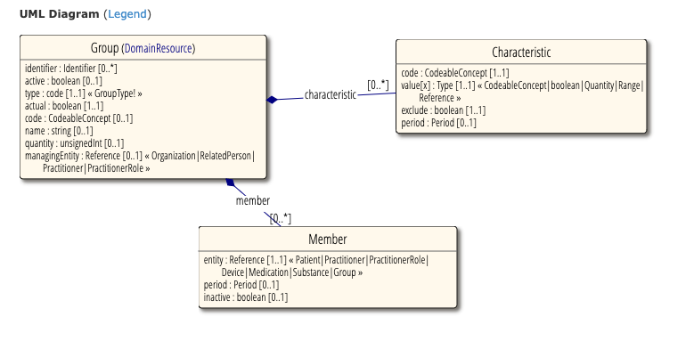
The Group Resource

Slide 14
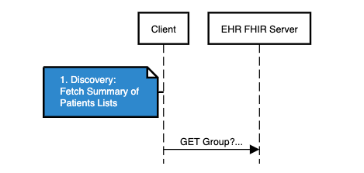
1. Discovery
Use Group Resource
Ability to Search by characteristic
Location
Practitioner
Organization
CareTeam
Ability to Search by manager of List
Use Summary Search to limit payload size

Slide 15
Example Search Syntax for Getting all the available Patient Lists
`GET Group?_summary=true&type=person&
characteristic=[Code value]&
value-reference=[Value value]
* value-reference is a custom SearchParameter in FHIR R4 added to FHIR R5

Slide 16
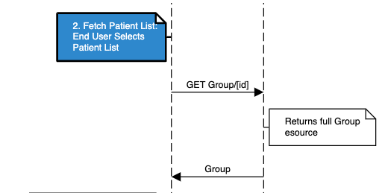
2. Fetch Individual Patient List
Patient list is selected using a simple Fetch operation:
/Group/[id]
End User gets the list of Members

Slide 17
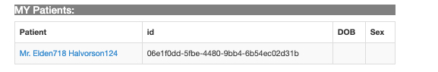
Are We Done?....
… Maybe, but typically need more data about the patient
etc.

Slide 18
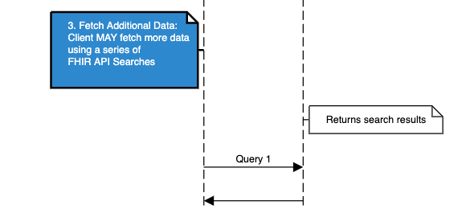
3. Fetch Additional Data about each Patient
The Simplest approach is to do a series of queries on the Server to fetch additional data…

Slide 19
Getting additional Data Using Search
for each patient in Group:
GET Patient/ID
GET Observation/$lastn?patient=Patient/ID&category=laboratory
Notes:
Patient id is provided by the Group we just fetched

Slide 20
When a Patient Based Query Fails
Sometimes a patient based query isn’t going to get you what you want…
Returns requested data
???

Slide 21
Get the Specific Encounter or Appointment that defines the Group Membership
A patient-based search on Encounter or Appointment may not give you only the one you are interested in
Group
0..* Group.members
Group.member.extension to reference the specific Encounter or Appointment which define the group membership:
For example, the appointment for each patient I am seeing today.
Group
Notes:
A patient-based FHIR Query may not give you the data you want.
For example, a calculated score, a real-time measurement, an alert, even current graph or chart.

Slide 22
Fetching Additional Data Using Questionnaire
Group
Group.extension that references a Questionnaire form defining the data that is provided for each patient (Group.member)
0..* Group.members
Group.member.extension that references the filled out form (QuestionnaireResponse) supplying the patient data defined by the Questionnaire (filled by server not the patient)
Group
Notes:
A patient-based FHIR Query may not give you the data you want.
For example, a calculated score, a real-time measurement, an alert, even current graph or chart.

Slide 23
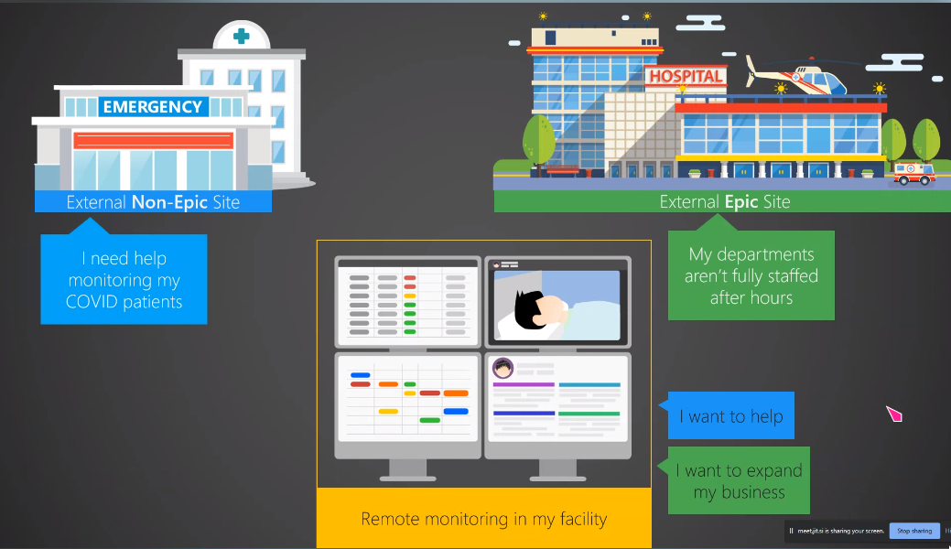
Using the Questionnaire Extension - Remote Monitoring
Thank you to Epic for sharing this content © 2020 Epic Systems Corporation
Notes:
Use cases for specialized care; off-hours care -- without requiring external clinicians on the viewing/supporting end to *store* data on their end.

Slide 24
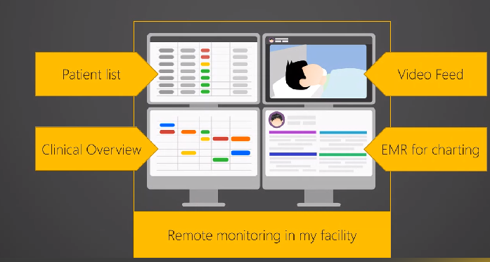
Using the Questionnaire Extension - Remote Monitoring
Thank you to Epic for sharing this content © 2020 Epic Systems Corporation
Notes:
At the core (upper left), patient lists with details about each individual. Source site can capture / calculate relevant metrics in a timely manner, and clinicians can open EHR to dig in or get further details. a “heads-up display”, sortable by columns like risk score

Slide 25
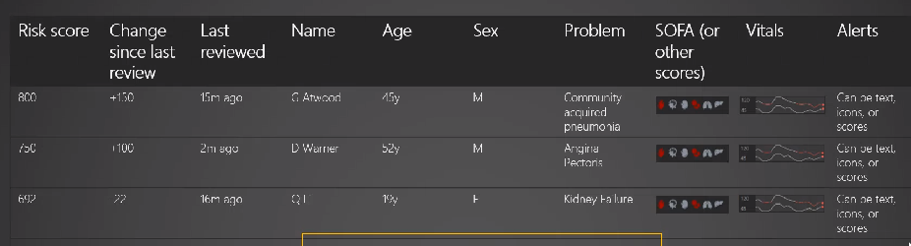
Using the Questionnaire Extension - Remote Monitoring
Thank you to Epic for sharing this content © 2020 Epic Systems Corporation
Notes:
a “heads-up display”, sortable by columns like risk score, Real time calculated data, not available as fhir resource. All defined by the Q resource and data suppied by the QR

Slide 26

Implementation Experience
HL7 Connectathon 25: Sept 10th,11th
Servers: Cerner, Meditech, Microsoft,
Clients: Apple, Epic, Microsoft, Argonaut Test App
Accomplishments:
Able to demonstrate basic proof of concept for above workflow for both Clients and Servers
Identified Several Issues

Slide 27
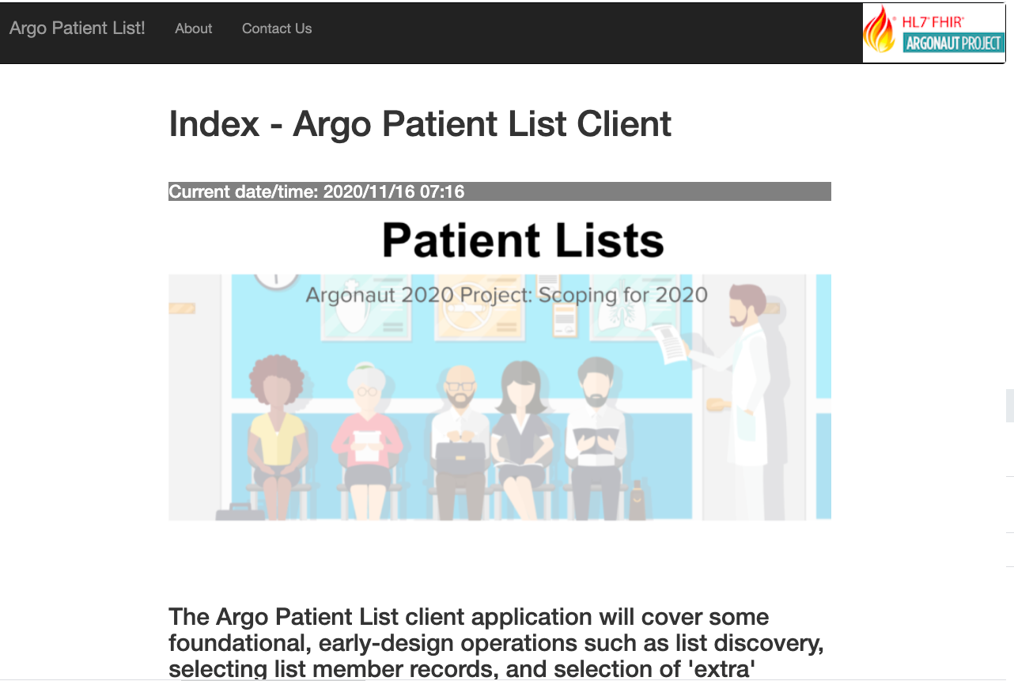
Demonstration Applications

Slide 28

Argonaut Patient List Roadmap
April | Kickoff
May-June | Define Scope and API Design
July - August | Draft and Iterate on IG and prototype implementations
September | Connectathon Track - test multiple servers and clients
October - December | Iterate on IG and prototype implementations
January 2021 | ???: Ballot IG
 | Connectathon Track - test multiple servers and clients

Slide 29

Next Steps
HL7 FHIR January Connectathon
More Testing Capacity
Focus on getting additional Data using Q/QR
Large Lists
Getting Encounters and Appts that defined membership on the list
Publish Argonaut Implementation Guide
After more implementation experience hand off to HL7 for publishing as an HL7 IG.
Notes:
Jan 13, 2021 to Jan 15, 2021 - Virtual Event

Slide 30
Argonaut Patient List Resources
Patients lists Wednesday 1-2 PM EDT (Next Meeting ...)
Running meeting notes
Draft API (sequence diagrams, FHIR artifacts)
2020-09 Patient Lists Connecthon 25 Summary
Codelab exercise: https://aka.ms/patient-lists-codelab
Test Client App Argo Patient Lists Test App

Slide 31
Q&A

